Slide 1
Digital Dashboard Capstone
Team Members: Sean Koppenhafer, Jaime Rodriguez,
Chad Thueson, Noah Erickson, Rishal Dass
Notes:
Slide Purpose: Introduce ourselves
<number>

Slide 2
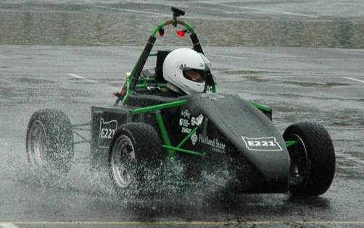
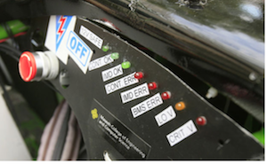
Project Overview
Electric systems add complexity and a traditional LED dash would not suffice
Drivers must be aware of system faults and warnings
A Digital Dashboard must be created to accommodate additional electrical systems
Formula SAE Electric Car
Traditional LED Dashboard
Notes:
Slide Purpose: What did we have to do
<number>

Slide 3

Requirements
Size
LCD Screen < 4”
Compact system
Price
$500 Budget
Inexpensive reproducibility
Features
User friendly
Plug and play
Water resistant
Notes:
Slide Purpose: Show requirements linked to decisions
<number>

Slide 4
Consideration – Microprocessor
System | Cost | Custom Board | CAN Controller | CAN Library | SPI, I²C, UART, etc
ATMEGA328 | $3 | Yes | No | No | Yes
AT90CAN | $8 | Yes | Yes | Yes | Yes
Arduino Uno | $25 | No | No | No | Yes
Arduino Due | $50 | No | Yes | Yes | Yes
ATSAM3X | $12 | Yes | Yes | Yes | yes
The ATSAM3X was chosen for the following:
Same microprocessor as Arduino Due
CAN library available
ATSAM3X
4DSystems LCD
CAN Communication
Digital Dashboard
Notes:
Slide Purpose: Why we chose the ATSAM3X
<number>

Slide 5
Consideration – Screen
Company | Cost | Size | Color | Sunlight Visibility | Software
EarthLCD | $219 | 3.5” | Yes | Yes | Yes
New Haven | $60 | 4.9” | No | Yes | No
Sun LCD | ??? | 3.5” | Yes | Yes | No
4D Systems | $89 | 3.5” | Yes | No | Yes
The 4D Systems Screen was chosen for the following:
Design software available
Affordable full color touchscreen
ATSAM3X
4DSystems LCD
CAN Communication
Digital Dashboard
Notes:
Slide Purpose: Why we decided on the screen
<number>

Slide 6
Consideration – Comm. Protocol
Protocol | System Integration | GEVCU Capability | ATSAM3X Compatibility
I²C | Simple | Yes | Yes
SPI | Simple | Yes | Yes
CAN | Moderate | Yes | Yes
Wi-Fi | Complex | Yes | No
The CAN protocol was chosen for the following:
Vehicle components already running on CAN
ATSAM3X
4DSystems LCD
CAN Communication
Digital Dashboard
Notes:
Slide Purpose: why we decided on CAN
CAN was already implemented
<number>

Slide 7
System Overview
CAN Buses
GEVCU
Microcontroller
LCD Screen
Power Supply
Notes:
Slide Purpose: Show how the system connects
<number>

Slide 8
Printed Circuit Board
Compact size
2-Layer design for easy reflow
Multiple power supply input voltages
Features
Based on an Arduino Due
5V or 12V power sources
Programming port
CAN0 high and low
CAN1 high and low
LCD Mating
Header
CAN Inputs
Inputs
LCD mating header
Outputs
Programming Circuit
12V Supply
Notes:
Slide Purpose: Show off our awesome PCB
<number>

Slide 9
Software
Arduino CAN library receives bus data
Messages are interpreted
Update screen with Arduino 4D Systems library
Notes:
Slide Purpose: Show off our awesome software
<number>

Slide 10
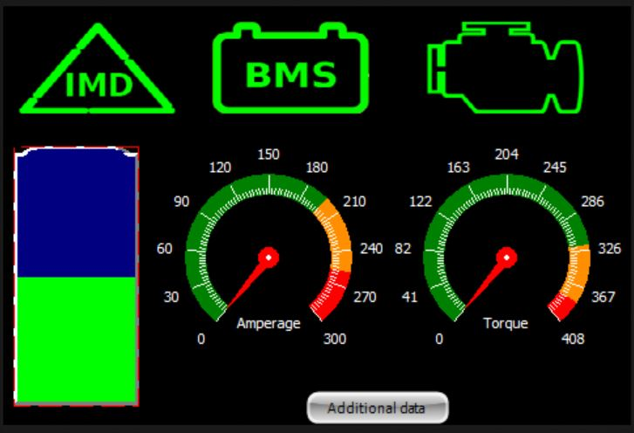
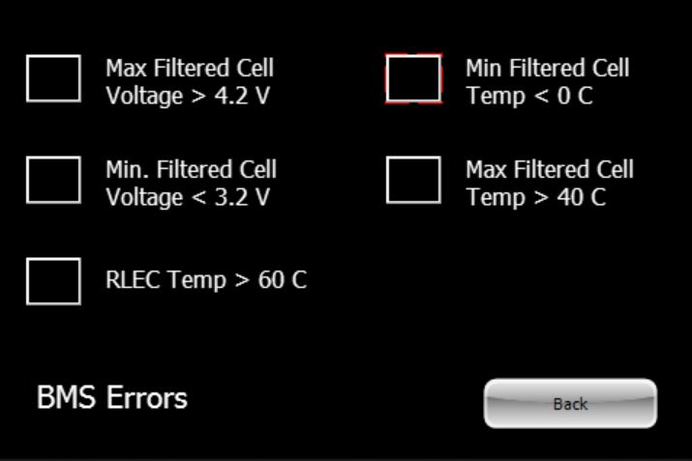
GUI
Created with 4D Systems IDE
Simple design for quick driver interpretation
Touch enabled subscreen buttons
High contrast for viewing in sunlight
Main Screen
BMS Subscreen
Notes:
Slide Purpose: Show GUI decisions
<number>

Slide 11
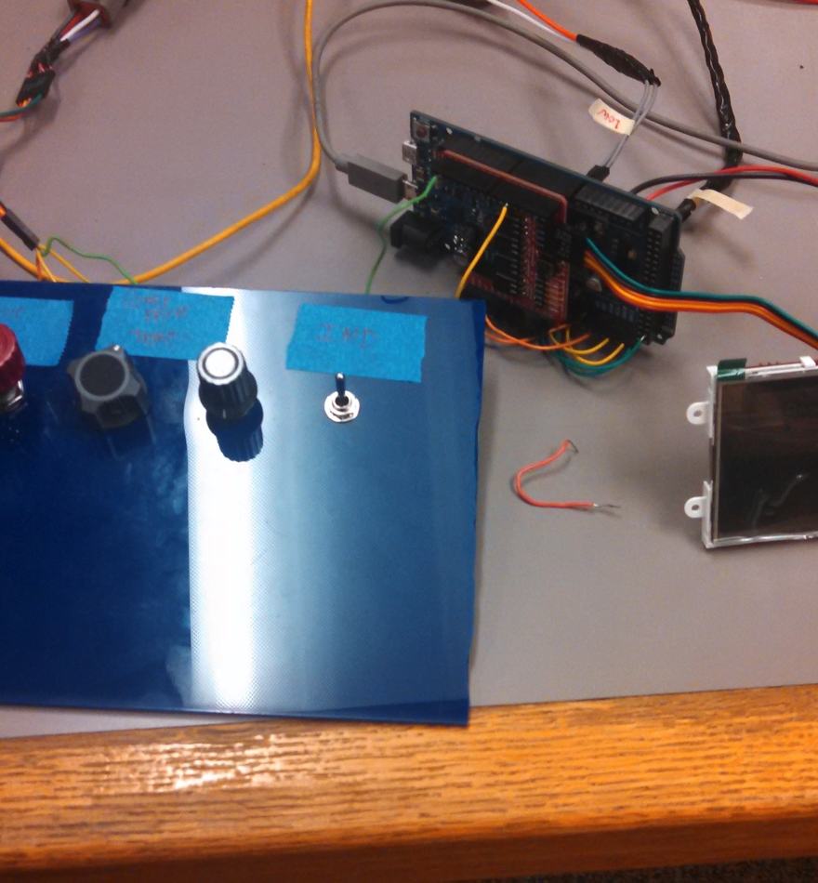
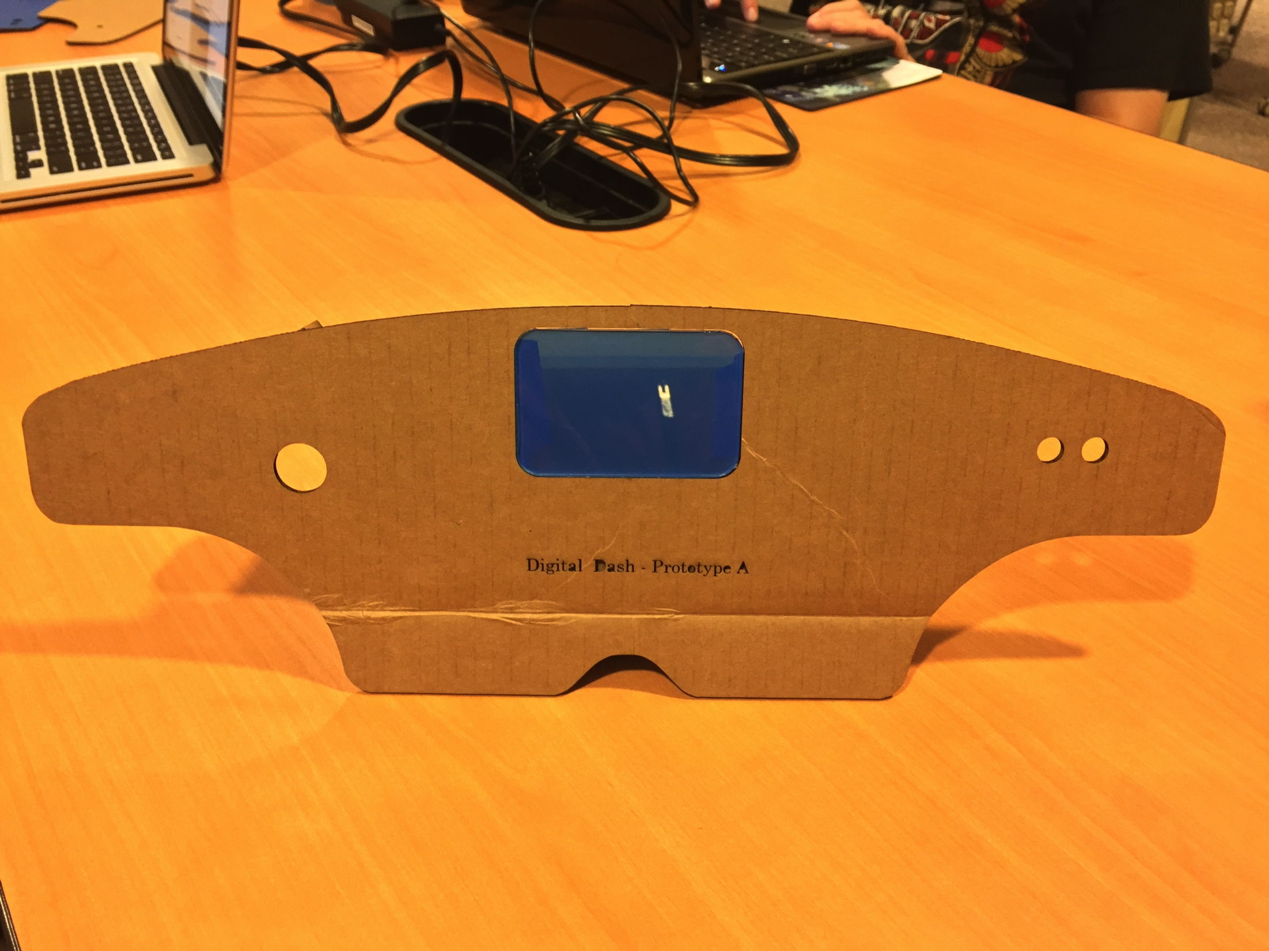
Testing
Demo Unit
Electric Vehicle
Analog inputs to simulate vehicle
Capstone poster session
FLAWLESS VICTORY
PLACEHOLDER PICTURES
Demo Unit
Electric Vehicle With Digital Dashboard
Notes:
Slide Purpose: Talk about demo unit?
<number>

Slide 12
Reproducibility
Hardware
Custom board schematics on Github – order through your favorite PCB manufacturer
We suggest a 4D Systems Screen
Note GUI sizing may need to be changed
Software
Very specific to vehicle components
Message IDs WILL need to be changed if components differ
Develop code and program from the Arduino IDE
Enclosure
Must be water resistant
The file used to laser cut acrylic in Inkscape is also on Github
Notes:
Slide Purpose: Show how to reproduce a unit
Scheduled FOR DELETION
<number>

Slide 13

Documentation
Software code
Schematics and layouts
Reproduction instructions
Development roadblocks, milestones and progress meetings
Budget, bill of materials and schedule
Test plans
Notes:
Slide Purpose: Show what documentation we have
<number>

Slide 14
Future Revisions
Enclosure
Smaller
Software
Polling Based
Mainboard
Programming Circuit
LCD Header
Microprocessor with more CAN mailboxes
Revision 2.0
Notes:
Slide Purpose: Show what we could improve
<number>

Slide 15
Conclusion
Get clarification early and often
Check basic functionality of the hardware and software early in the development process
Check the wiring
Create a simulation program for testing when the official test vehicle is not operational
Don't duel unless you are willing to risk being sent to the shadow realm
Notes:
Slide Purpose: wrap this up
<number>

